Slide 1



MILCS: An effective way of evaluating Information Visualizations
John Alexis Guerra Gómez, PhD
Information Visualization Researcher
Yahoo Labs
@duto_guerra
http://johnguerra.co
Electronic Imaging
Science and Technology
SPIE 2015

Slide 2
What changed in the us federal budget between 2008 and 2009?

Slide 3
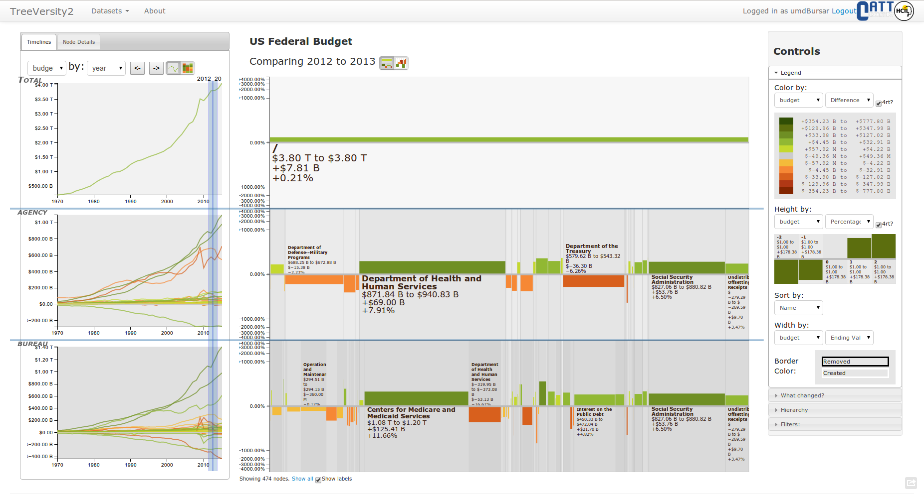

Slide 4
How can we evaluate it?
Controlled experiments
Measures specific features, not the system as a whole
Usability studies
Measures user satisfaction
Multi-dimensional in-depth long-term case studies (MILCS)
Measures user’s capacity to generate insights

Slide 5
Controlled Experiment
Usability Study
MILCS
Location Lab Lab In-situ
Users Random Random Experts
Data Artificial Artificial User’s data
Tasks Simple tasks/Imposed Simple tasks/Imposed User’s tasks
Duration 1-2 Hours 1-2 Hours Months
Results Quantitative Qualitative Qualitative*
Measures Speed, accuracy User satisfaction Insight generation

Slide 6
How to conduct a MILC?
Find an user with data and a problem
Commit the user
Document current approaches
Define success metric
Deploy your tool in the user’s environment
Hold weekly meetings
Fix bugs, provide features
Document success and failure
Conduct exit survey
https://www.cs.umd.edu/localphp/hcil/tech-reports-search.php?number=2006-12

Slide 7
MILC Example
What changes in the adverse effects reported for a drug?

Slide 8
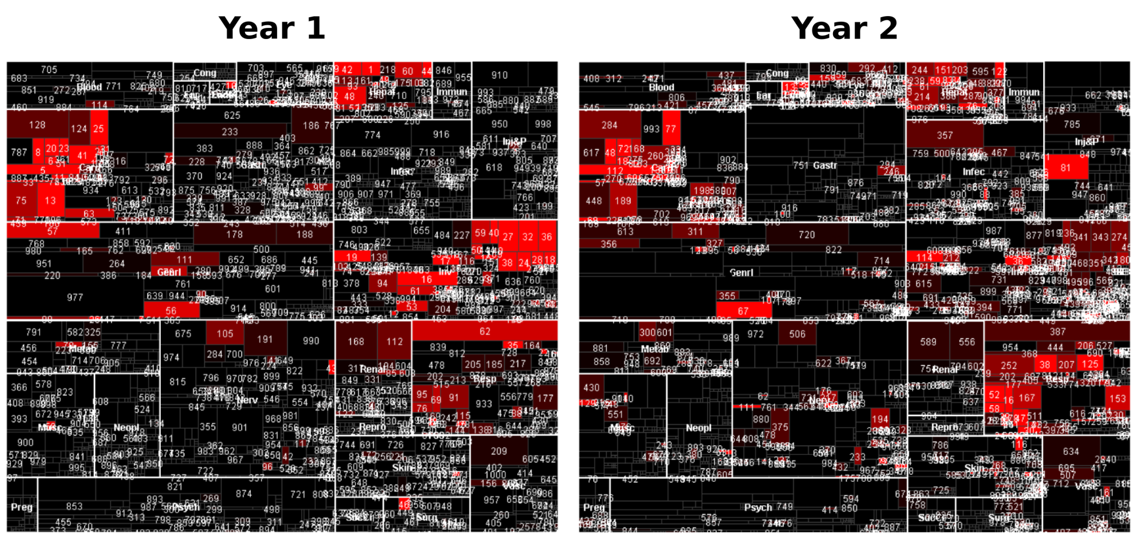
Before TreeVersity

Slide 9
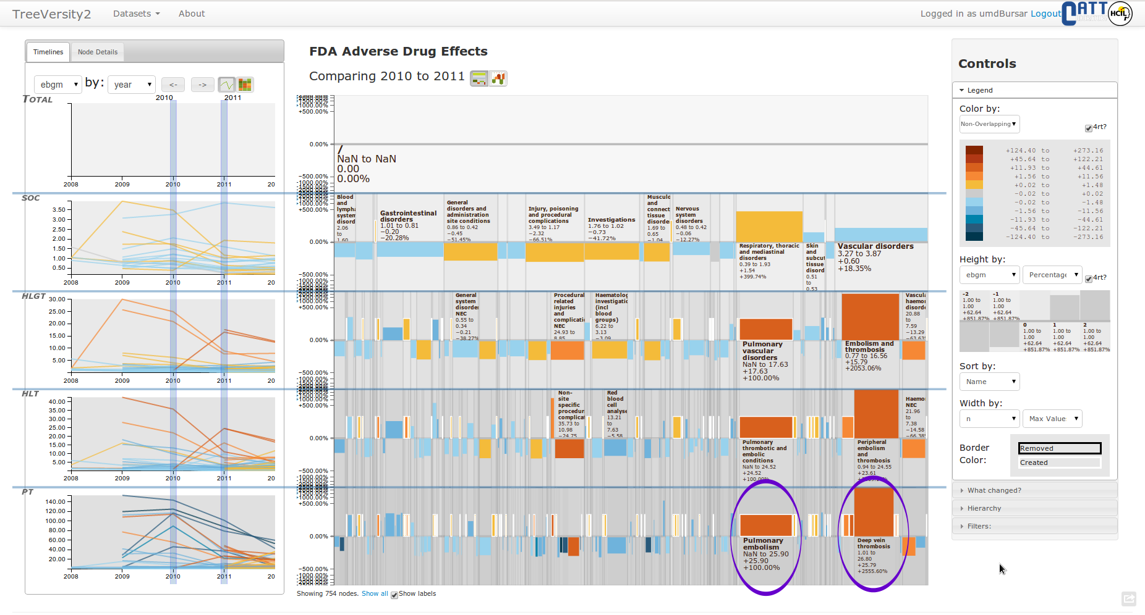

Slide 10
Take Home Message
MILCS, an effective way of evaluating complex systems
https://www.cs.umd.edu/localphp/hcil/tech-reports-search.php?number=2006-12
John Alexis Guerra Gómez, PhD
Information Visualization Researcher
Yahoo Labs
@duto_guerra
http://johnguerra.co
Electronic Imaging
Science and Technology
SPIE 2015

Slide 11
13 Case Studies that revealed strengths & weaknesses
13 case studies with 9 partners

Slide 12
Organization | Case Study | MILCS Stage | Driving Mode | TreeVersity Version | Data Size | Time Points | Example Tree Size | Number Attribs. | Number Vars. | Type of Tree | Tree Comparison Type
DOT | Airlines Budgets | Early | Chauffeur | 1 | 216 |  | 187 (2 Levels) | 3 | 1 | Dynamic | Type 3: aggregated + different topology
OMB | US. Federal Budget | Early | Chauffeur | 1 & 2 | 4,845 | 56 | 1,393 (4 Levels) | 7 | 1 | Mixed | Type 3: aggregated + different topology
DOT | TRB Publications | Early | Chauffeur | 1 & 2 | 52,135 | 8,012 | 674 (2 Levels) | 20 | 1 | Dynamic | Type 3: aggregated + different topology
DOT | Nat. Trans. Library Publications | Early | Chauffeur | 1 & 2 | 38,351 | 374 | 294 (3 Levels) | 10 | 1 | Dynamic | Type 3: aggregated + different topology
DOT | Passengers flying in the US | Early | Chauffeur | 1 & 2 | 65,534 | 162 | 4,194 (3 Levels) | 4 | 1 | Mixed | Type 3: aggregated + different topology
NCI | National Cancer Institute | Early | Chauffeur | 2 | 1,716 | 13 | 101 (3 Levels) | 3 | 3 | Dynamic | Type 2: non aggregated + same topology
FDA | FDA Drug Adverse Effects | Mature | Chauffeur | 2 | 2,964 | 5 | 1,614 (4 Levels) | 4 | 4 | Fixed | Type 4: non aggregated + different topology
UMD | UMD Budget | Early | Chauffeur | 2 | 16,332 | 5 | 1,296 (3 levels) | 6 | 1 | Mixed | Type 3: aggregated + different topology
UMD Bursar | UMD Students Information | Mature | Chauffeur | 2 | 227,158 | 5 | 715 (5 Levels) | 219 | 3 | Mixed | Type 3: aggregated + different topology
eBay | eBay Product Sales Data | Early | User-driven | 2 | 63,098 | 4 | 5,443 (4 Levels) | 6 | 2 | Fixed | Type 1: aggregated + same topology
CATT Lab | Transportation Bottleneck Data | Early | User-driven | 2 | 96,205 | 24 | 286 (3 Levels) | 7 | 4 | Mixed | Type 3: aggregated + different topology
IDB | Imports and Exports in the Americas | Early | User-driven | 2 | 119,741 | 19 | 3,766 (4 Levels) | 5 | 1 | Dynamic | Type 3: aggregated + different topology
DUTO | Blind Students in Colombia | Mature | User-driven | 2 | 33,802 | 4 | 1,098 (3 Levels) | 21 | 1 | Mixed | Type 3: aggregated + different topology

Slide 13
“The work I can achieve with TreeVersity is equivalent to years of analysis with our previous methods”
“TreeVersity easily showed us multi-years of the data in a graphical form at once without having to download the data into excel and create graphics. We can do that analysis now, but TreeVersity was much quicker.”
“I've spent many hours in color coded Excel files expressing changes at query and category levels. The visualization and what changed views made this process much more efficient and easier to share.”
“Numerous examples of obvious, but heretofore unrevealed patterns were discovered.”
“We use Hyperion and excel for analysis. However, TreeVersity made it much easier to see multi-year trends.”

